Slide 1


Slide 2

Introduction
A database of a store that sells baked goods. This database will hold all the admin and user information as well as all the products, ingredients, and machine information. The admin will have the full privilege to insert, update and delete information. While the user will have the limited privileges of accessing data.

Slide 3
Individual contribution:
Since we are a group of 7 students, we have created 7 strong entities each member created his own entity on MySQL, the entities constrains, and filled it with data. Then the group members conducted a zoom meeting to write the queries and create users to the database together.

Slide 4
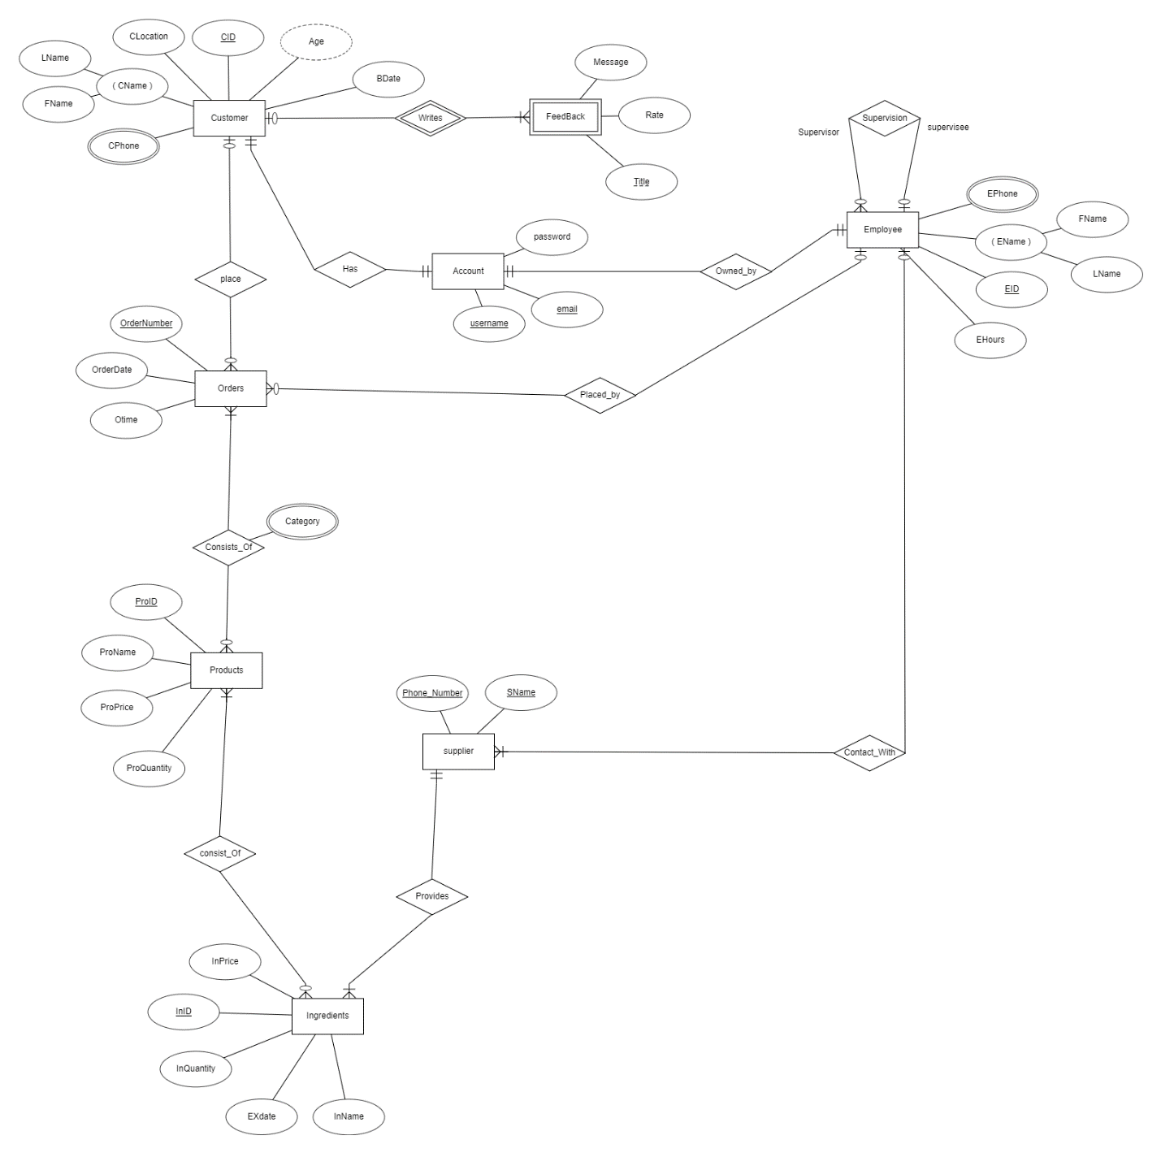
ER diagram :

Slide 5
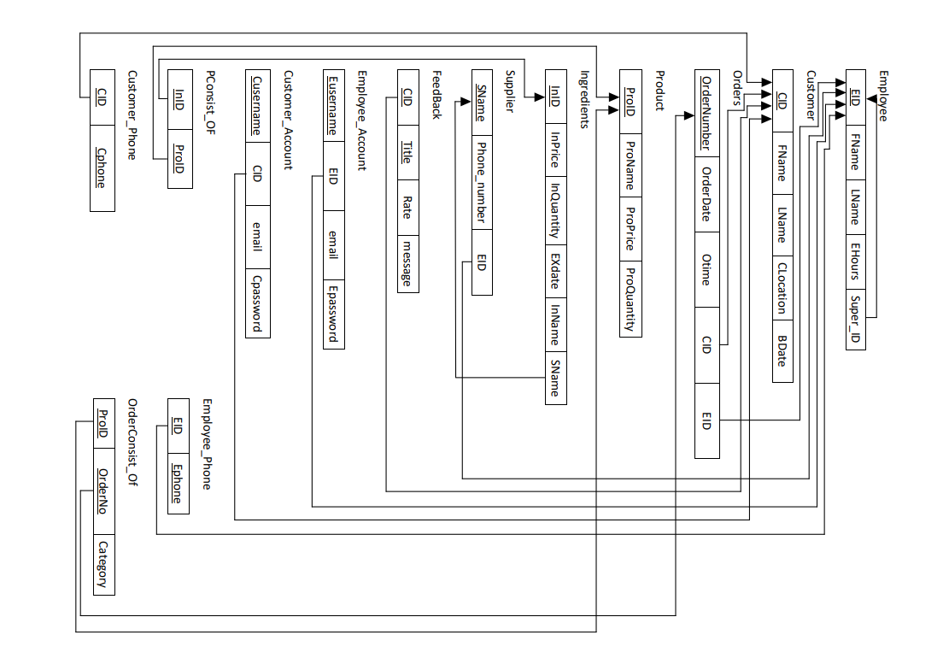
MAPPING
of Your
ER diagram
Into
Database Schema:

Slide 6
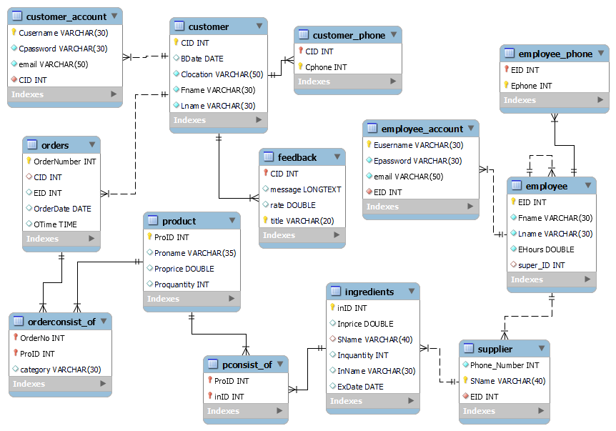
Database Diagram:

Slide 7
User Privilege:
User Privilege:
user | privileges
Manager | Account limits | can execute 100 query per hour and 200 updates in one hour.
 | Administrative roles | has the right to perform all tasks.
 | Schema privileges | has all the privileges.
 | password | Ma78$ga19er
Employee | Account limits | can execute 80 query per hour and 100 updates in one hour.
 | Administrative roles | Maintain and monitor the database along with full rights on the database and the ability to revers engineer any database schema (An employee can add but can not remove anything).
 | Schema privileges | Can use all object rights along with some of DDL rights.
 | password | Em%05pl+33oy
User | Account limits | can execute 30 query per hour and 30 updates in one hour.
 | Administrative roles | Has no administrative role.
 | Schema privileges | Can use create, update, and show view only (from object rights).
 | password | Us/42er@00

Slide 8

Tables

Slide 9
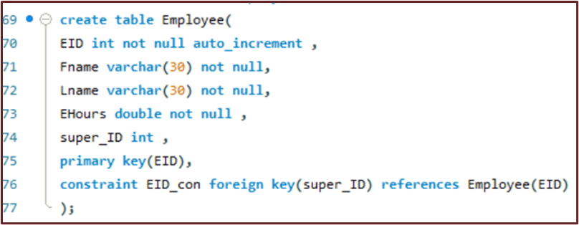
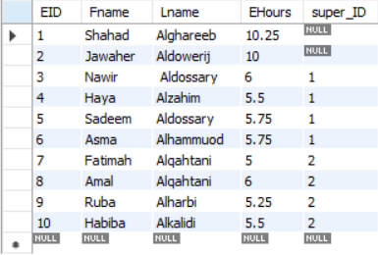
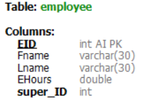
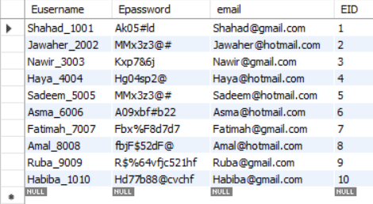
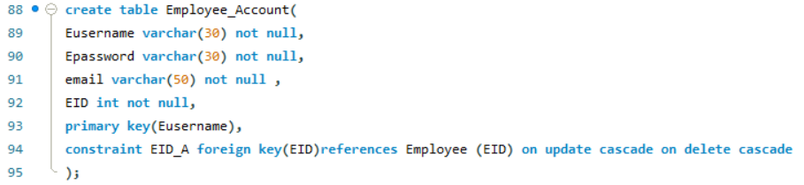
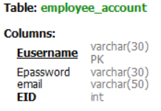
Employee:
Employee_Account:

Slide 10
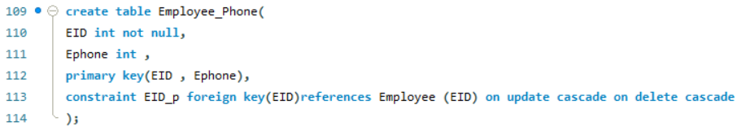
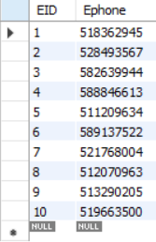
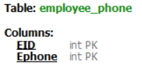
Employee_Phone:

Slide 11
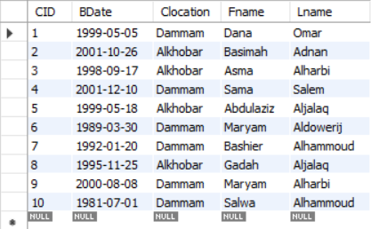
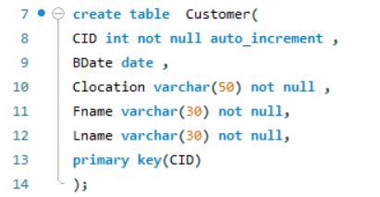
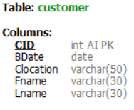
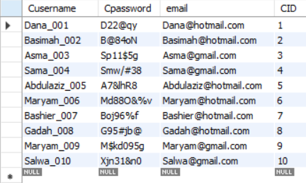

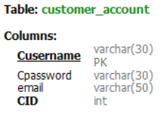
Customer:
Customer_Account:

Slide 12
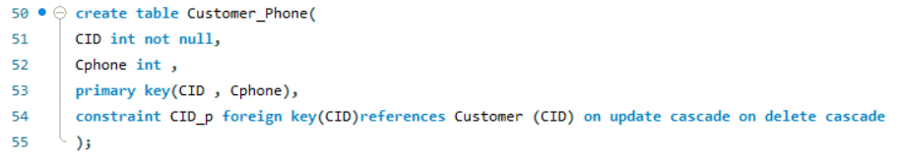
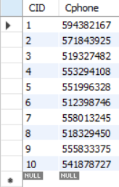
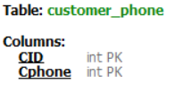
Customer_Phone:

Slide 13
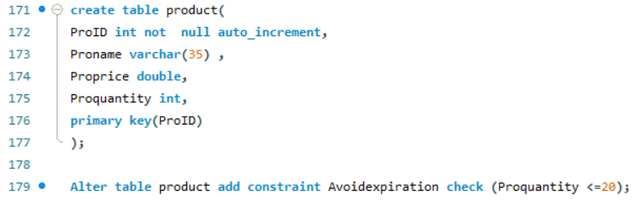
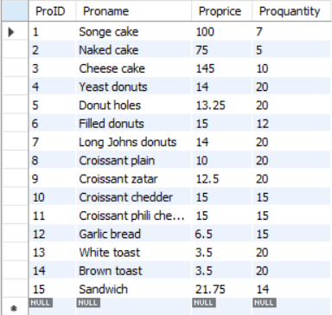
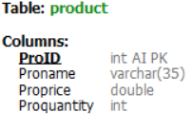
Product:

Slide 14
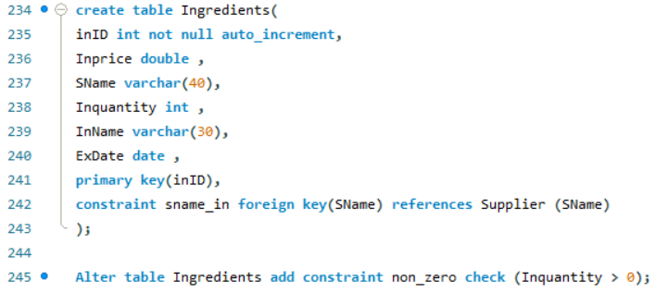
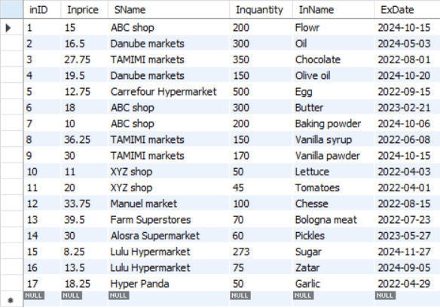
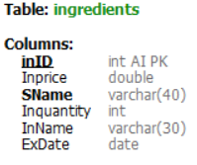
Ingredients:

Slide 15
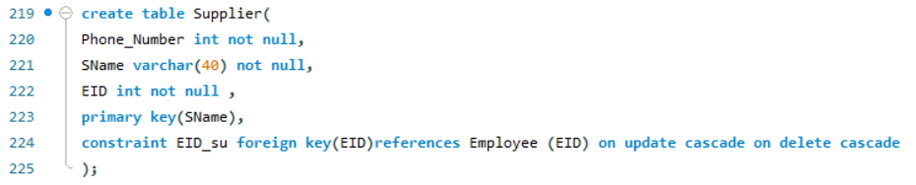
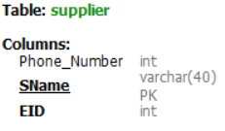
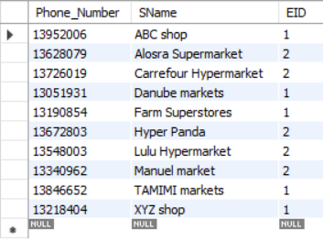
Supplier:

Slide 16
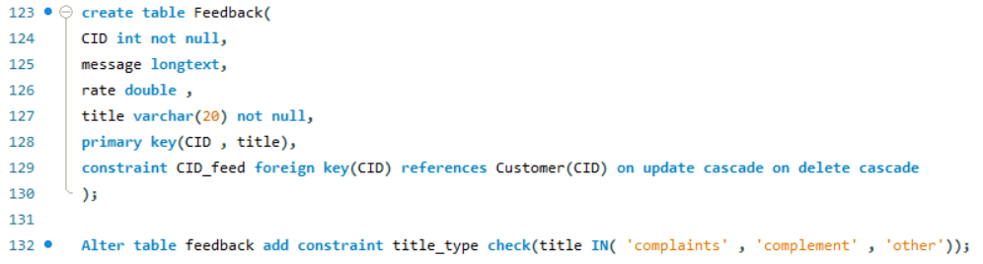
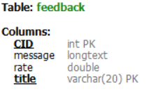
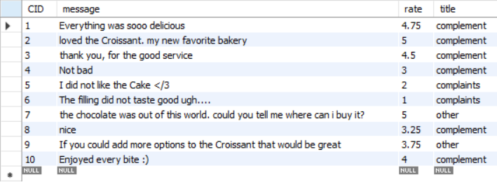
Feedback:

Slide 17
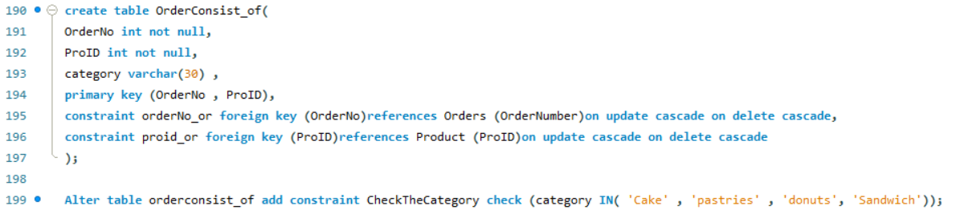
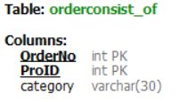
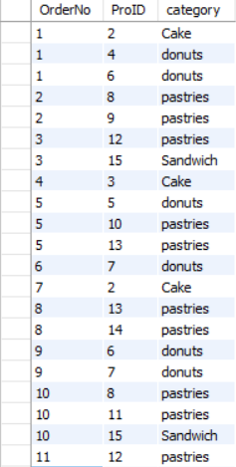
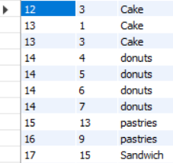
Orderconsist_of:

Slide 18
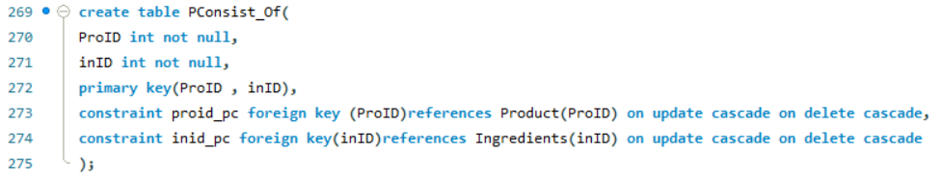
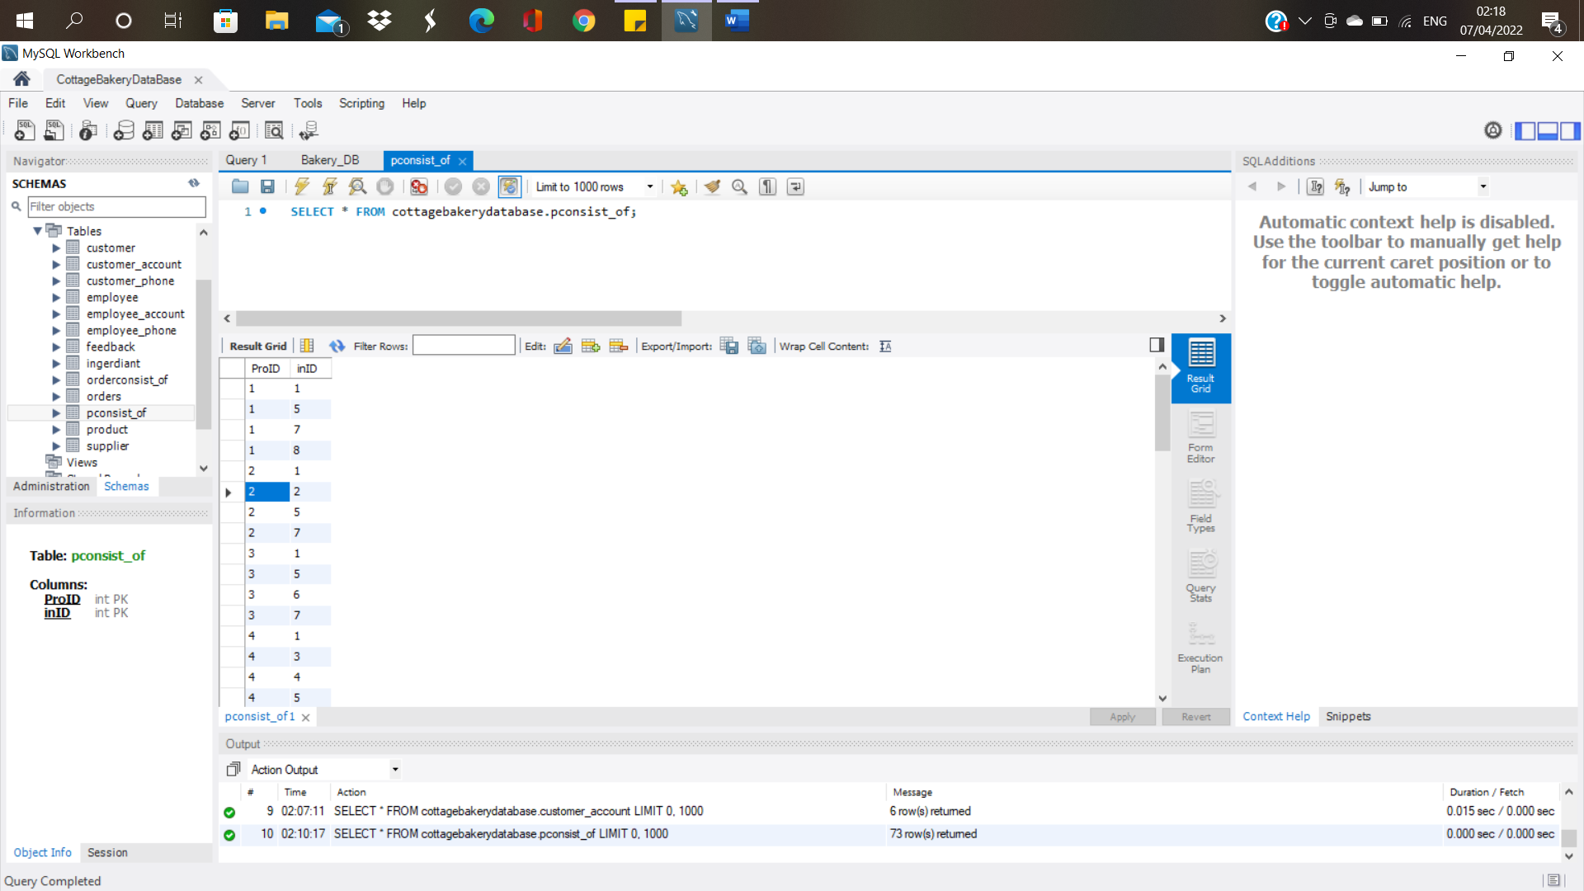
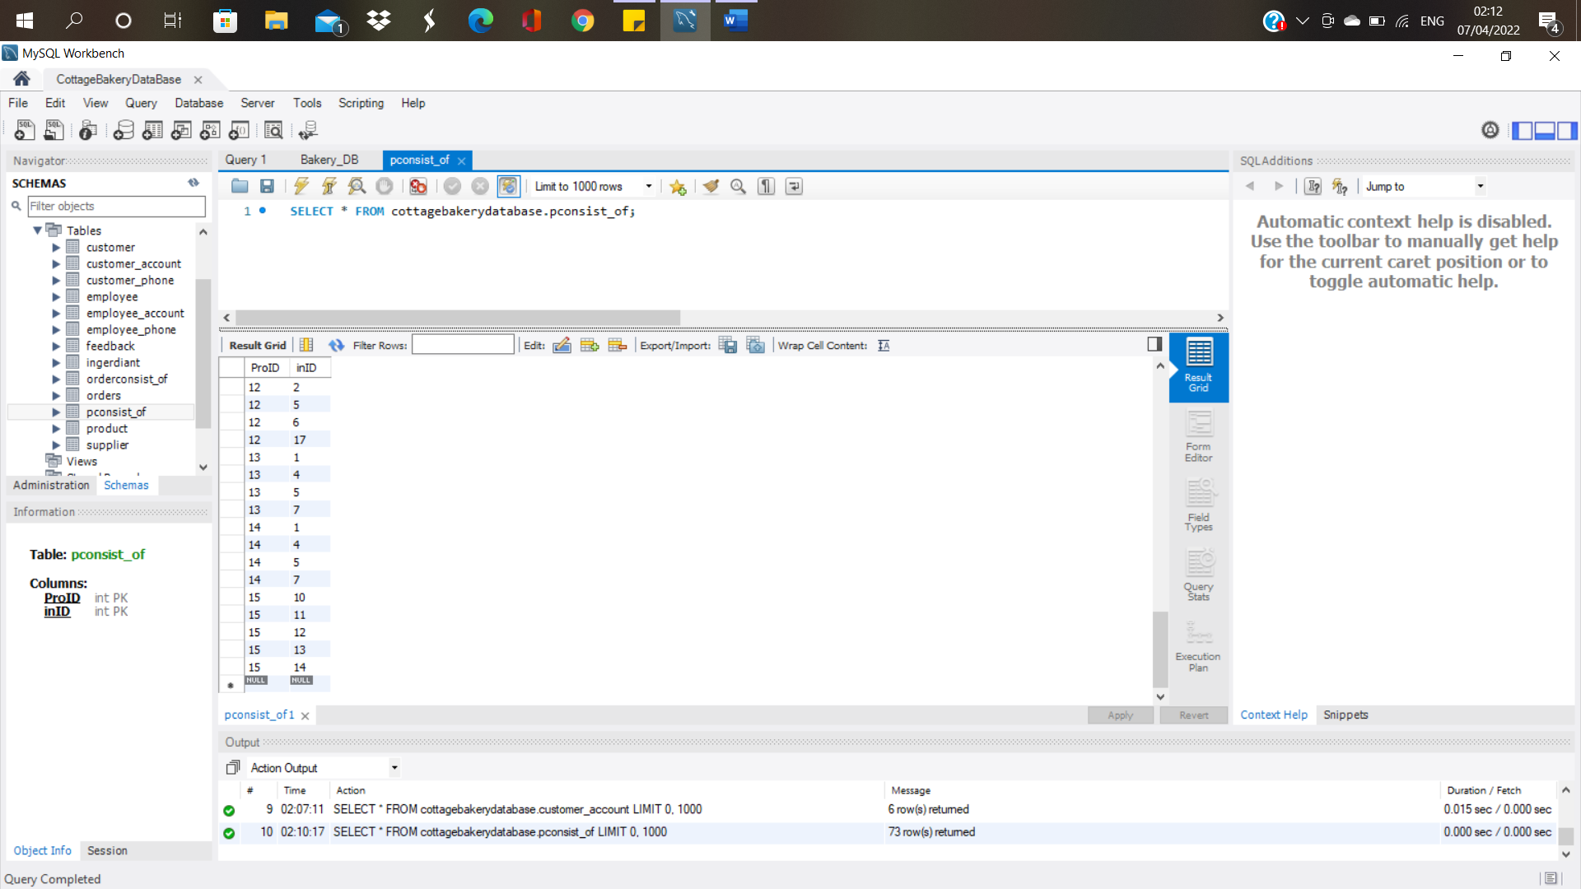
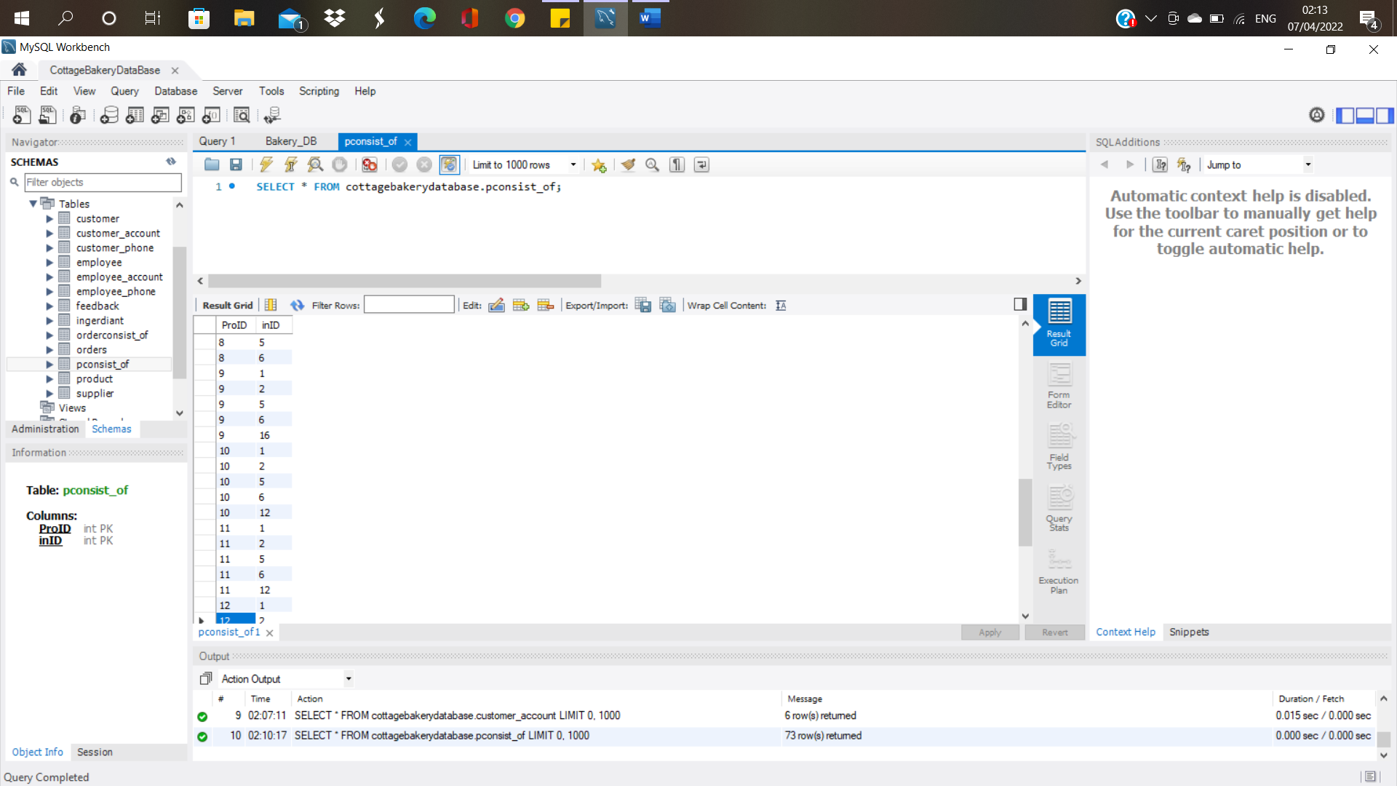

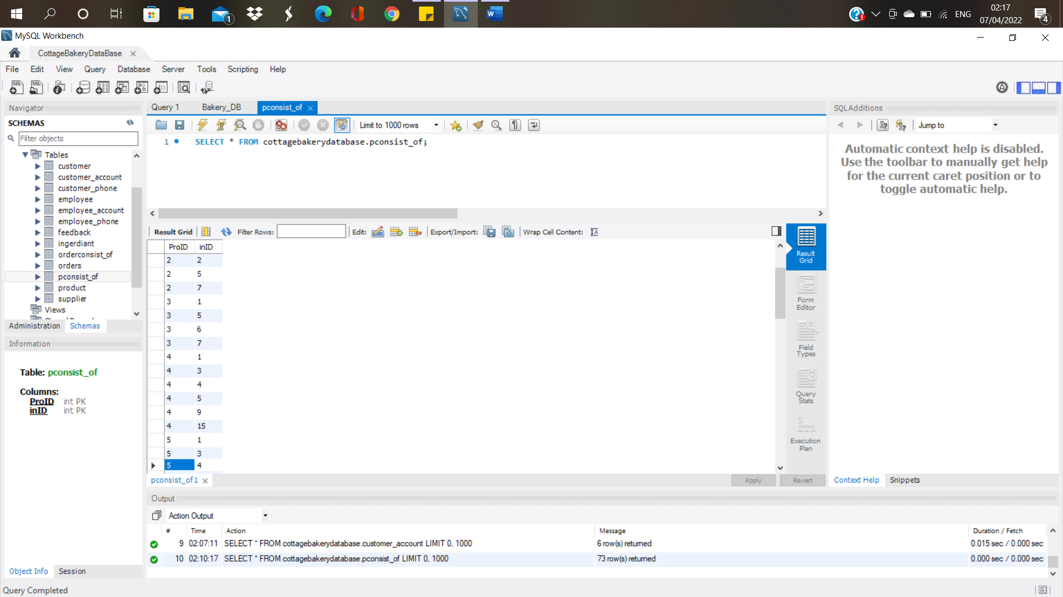
PConsist_of:

Slide 19
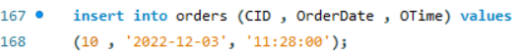
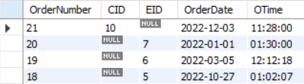
In this query we will add a new order, orders can be taken by a customer that already is in the system (website) or
taken by an employee who placed the order for an unregistered customer (physical store).
Unregistered Customer :
Registered Customer :
Output:

Slide 20
Queries

Slide 21
Insert
In this query we will add a new order, orders can be taken by a customer that already is in the system (website) or taken by an employee who placed the order for an unregistered customer (physical store).
Unregistered Customer :
Registered Customer :
Output:

Slide 22
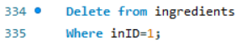
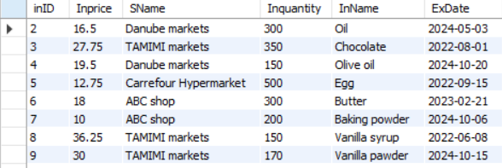
Delete:
In this query we will delete an ingredient with inID = 1.
Output:

Slide 23
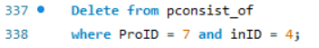
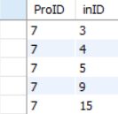
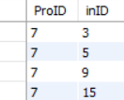
Delete:
in this query we will remove olive oil from Long Johns donuts.
Output:
Before After

Slide 24
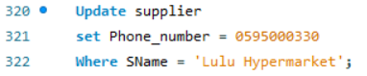
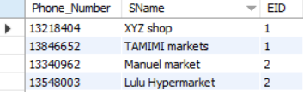




Update:
In this query we will update Supplier ‘Lulu Hypermarket’ phone number to 0595000330.
Output:
In this query we will change the oil used in Filled donuts from olive oil to oil.
Before After

Slide 25


Like:
In this query we will print the employee’s name and email who uses “Hotmail”.
Output:

Slide 26


Between:
In this query we will print the product name, Price, and quantity with price between 10 and 20.
Output:

Slide 27




IN:
In this query we will show the names and IDs of customers who submitted negative feedbacks which is (complaints).
Output:
In this query we will show all feedbacks information under the title (complaints and other).
Output:

Slide 28


Order By:
In this query we will print the products name and quantity that been ordered by quantity.
Output:

Slide 29


Is Null:
In this query we will print out the order number for orders placed by an employee for unregistered customers
Output:

Slide 30


Intersect (Exists) + distinct:
In this query we will show the date of orders placed by customers on the store website without repetition.
Output:

Slide 31



Union:
In this query we will print all products and ingredients names.
Output:

Slide 32


Except (Not in):
We will select all order numbers and categories that is not “Pastries”
Output:

Slide 33


Group by:
For each employee count the number of suppliers they are responsible of contact with them and change the name of for counting column to numberOf_suppliers.
Output:

Slide 34


Having:
In this query let's say we want to see the ingredients that we need more of from the market’s so, we will show the number of ingredients that has a quantity less than 100 and the supplier’s name contains ‘market’ in it.
Output:

Slide 35


Aggregation + case expression:
In this query we will print the number of orders from every category in the store.
Output:

Slide 36


Aggregation:
In this query we will show the products ID , name , and quantity with the highest quantity allowed.
Output:

Slide 37


Aggregation cont:
In this query we will show the feedbacks with the highest rate, the name of the customer, their message and ID.
Output:

Slide 38


Aggregation cont:
In this query we will show all orders information scheduled one week ago (the date this screenshot we taken is 28/4/2022).
Output:

Slide 39

Function:
This function will take the hours each employee worked as an input and give the salary for a day as an output. The output of this function is shown in the next query

Slide 40


View + Join + Compute Claues:
In this view we will show the ID, names, hours, salary and super ID(if any) for the hard-working employee where their working hours is greater than or equal 6 hours.
Output:

Slide 41

View + Join + Compute Claues cont:
This view will show the manager information.
Output:

Slide 42


View + Join + Compute Claues cont:
This view will show the all employee’s contact information which is name , phone number, and email.
Output:

Slide 43


View + Join + Compute Claues cont:
This view will show all the customer contact information as phone numbers and emails with their names and ages, the age is driven by customer Birth date.
.
Output:

Slide 44


Compute Claues:
In this query we will take the price average from both ingredients and product to check if the store is profiting or losing.
Output:

Slide 45




Trigger:
If new order has been added the quantity of the product that has been ordered will decreases
Before adding new order, quantity is:
Output:

Slide 46


Not exists:
In this query we will show the orders number and date that were placed by registered customers through store website.
Output:

Slide 47
Thank you
That’s all, we hope you enjoyed the presentation.

